Slide 1
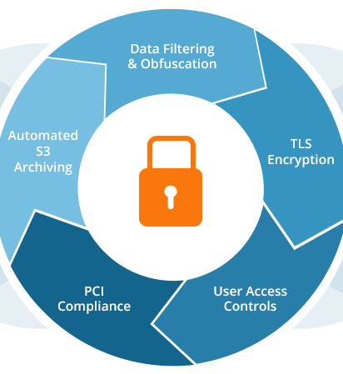
Aleo Shield
Identity And SECURITY SOLUTION

Slide 2
What Is Aleo Shield ?
An AI powered log analyzer to ensure the below security compliance in Log files
My idea is to analyze log files of Aleo transactions done with aleo commands and provide identity and security analytics on the data
System of Record (SOR) :
Information storage and retrieval system
Multiple data sources with remote access.
Log Data Storage in a generalized format
Security Orchestration, Automation, and Response (SOAR) :
Threat and vulnerability management, incident response and security operations automation
Automatic execution of tasks like vulnerability Scan , log File Insights
Security Information and Event Management (SIEM) :
Solution that helps organizations recognize potential security threats and vulnerabilities
It surfaces user behavior anomalies and uses Machine Learning Algorithms
Automate manual processes associated with threat detection and incident response

Slide 3





Data Flow in Aleo Shield
Respond to threats with actionable emails
Github
Introducing the platform and showing the features
Upload the Log file and validating the columns required for FinTech Domain
JSON form asking options – Checkboxes for all ML algorithms, SOAR charts, schedule
The Jupyter notebook with all the AI Logic and stats logic written
SOR, SOAR, SIEM Analytics
Responses for Threats and Incidents – Email Templates

Slide 4
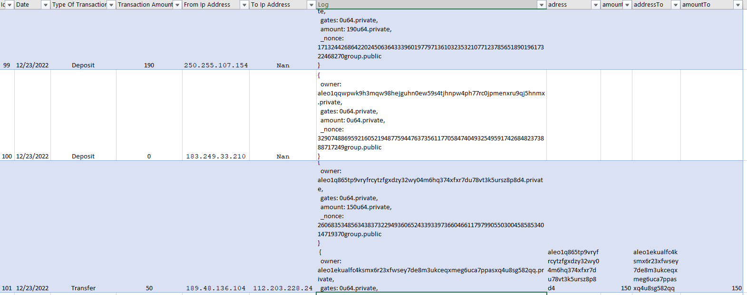
How we achieve SOR
All parties agree on a SOR Schema/template to be recorded
Multiple log formats are normalized to match the SOR Schema
The data is then cleansed
We can run enrichment like date/time formats, cities etc.
A sample SOR format taken is shown below for Aleo

Slide 5
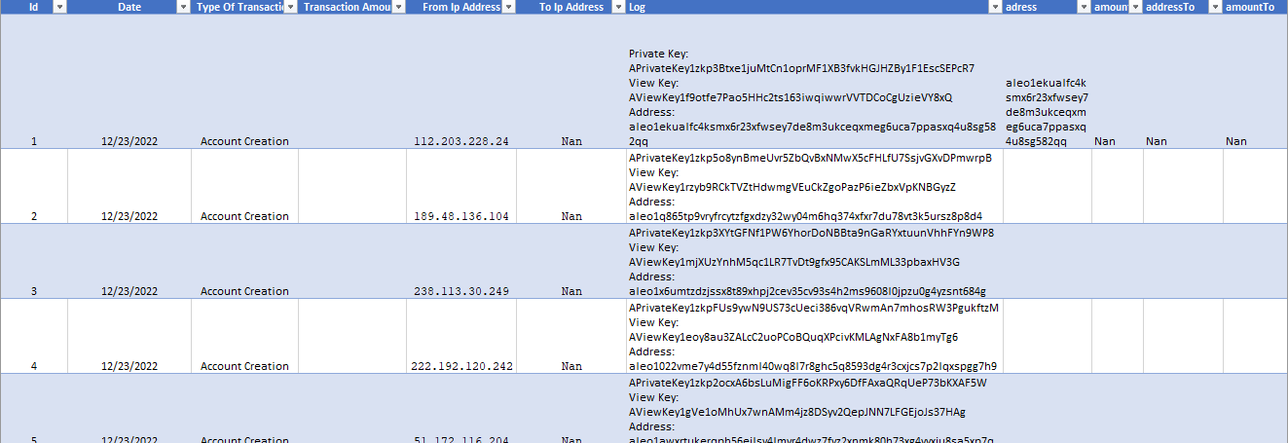
Aleo Raw Log Format Captured with Issue, withdraw, transfer events

Slide 6
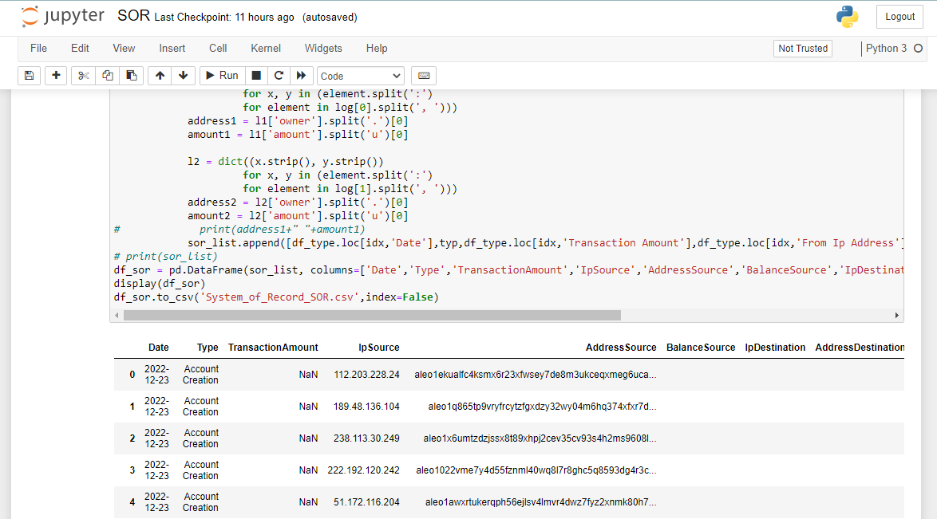
SOR Creation in python

Slide 7
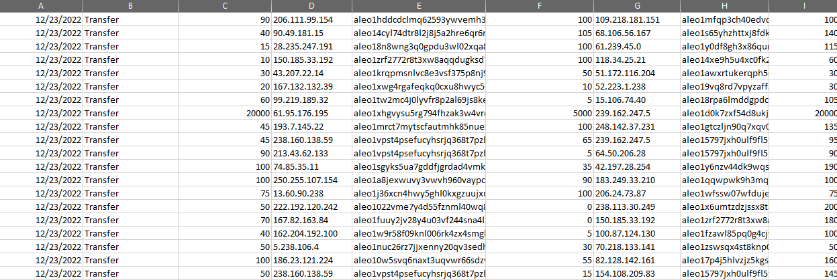
SOR(Refined, Normalised)

Slide 8
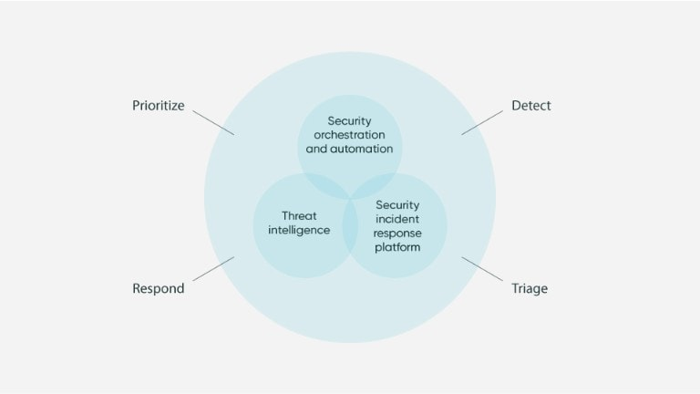
SOAR capabilities include:
Automated methods to process log Data
Identifying possible Anomalies
Visualization of Log’s Insights
Benefits of SOAR :
Effectively manage security incidents
Automate repeated and error-prone tasks
Prevent downtime and service outage by precisely identifying future threats

Slide 9
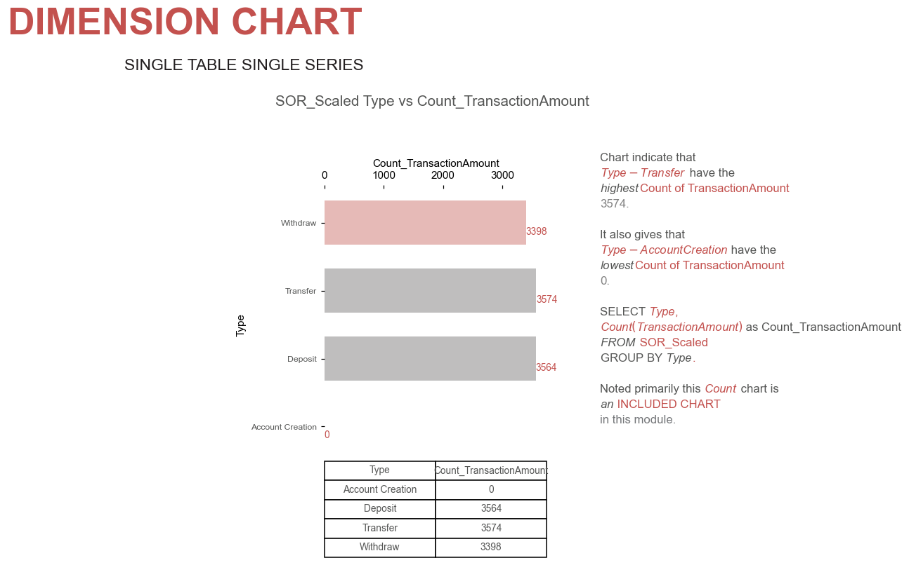
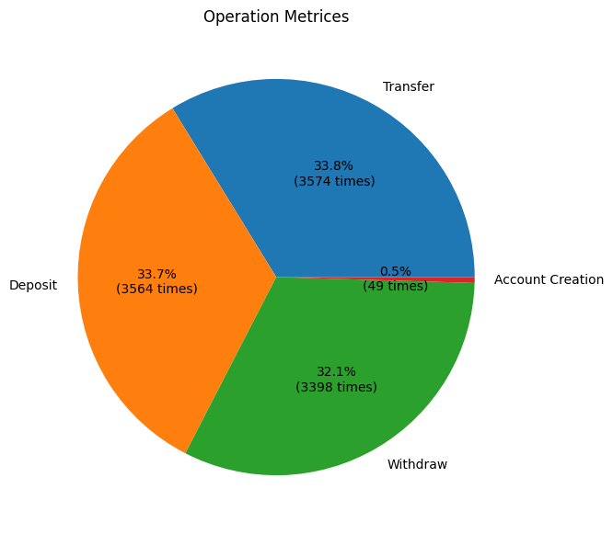
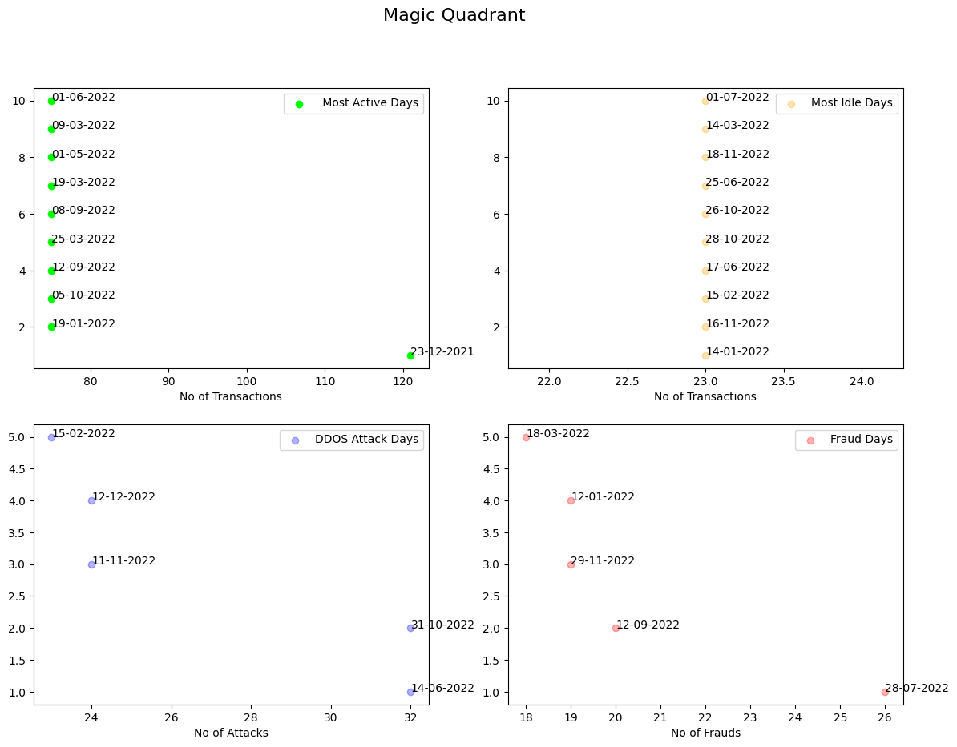
How we achieve SOAR
Metrics of SOAR
Total number of unique users
Total number of errors
Average number of transactions per User in a day , month and year
Magic Quadrant
Most Active Days having most transactions
Most Idle Days having only Few transactions
Frauds Days
DDOS Attack Days

Slide 10
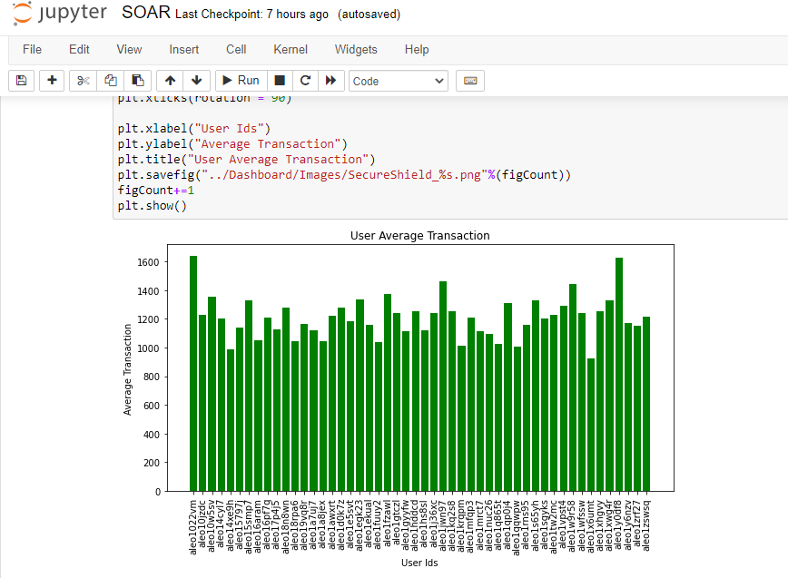
Analysis of Average Transaction Amount Per Account

Slide 11
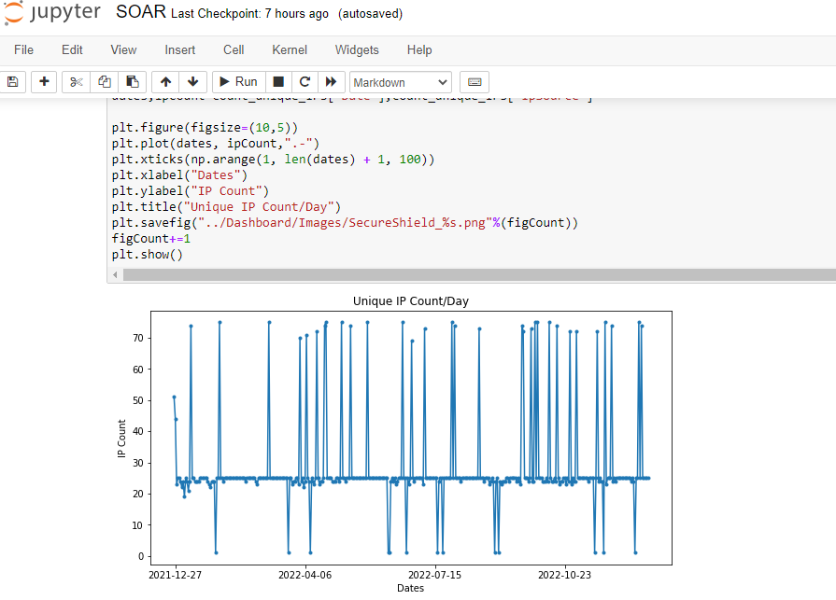
Unique IP Count per Day Analysis

Slide 12
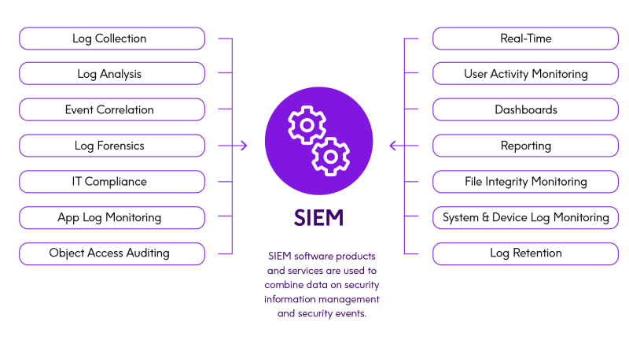
SIEM(Planned for future)
SIEM is a real time AI powered data analysis engine
As events happen on SOR, Machine learning algorithms like fraud detection act in real time and alert on possible security vulnerabilities

Slide 13

Fraud Detection using Classification Algorithms
What is Classification?
Classification can be performed on structured or unstructured data. Classification is a technique where we categorize data into a given number of classes.
Goal of Classification
Goal of a classification problem is to identify the category/class to which a new data will fall under.
How SIEM leverages this algorithm?
We’ll be using Labelled Historical Transactions Data to train our Classification Models and when any new transaction happens, we can classify whether this transactions is Fraudulent or not.

Slide 14
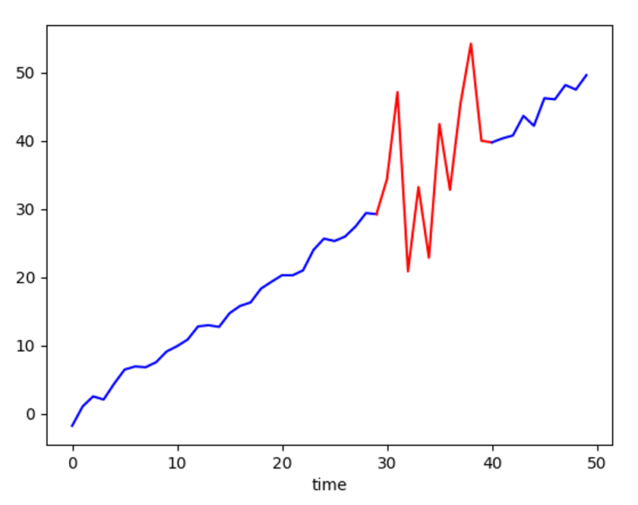
Anomaly Detection Algorithm
What is Anomaly Detection ?
Anomaly detection typically refers to the process of identifying outliers in a set of data that is largely composed of 'normal' data points. The idea is to find entries that were generated by a different process than most of the data.
How SIEM leverages this algorithm?
In the Data based on various frequencies (Daily , Weekly , Monthly , Quarterly) based on source addresses ,we are trying to find anomalous transactions.

Slide 15


